Slide 1
Multiple index access
Dr. Manjiree Mukesh Vyawahare

Slide 2
What is Indexing?
Indexing is a data structure technique which allows you to quickly retrieve records from a database file.
An Index is a small table having only two columns.
The first column comprises a copy of the primary or candidate key of a table.
Its second column contains a set of pointers for holding the address of the disk block where that specific key value stored.
An index -
Takes a search key as input
Efficiently returns a collection of matching records.

Slide 3
Types of Indexing
Primary Index
Secondary Index
Clustering Index
Multilevel Index
B-Tree Index
Advantages of Indexing
Disadvantages of Indexing

Slide 4
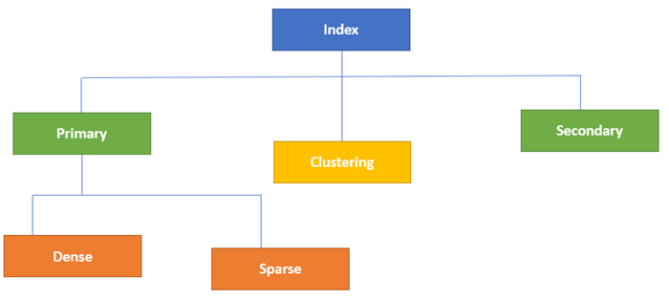
Types of index

Slide 5
Primary Indexing
Primary Index is an ordered file which is fixed length size with two fields.
The first field is the same a primary key and
Second filed is pointed to that specific data block.
In the primary Index, there is always one to one relationship between the entries in the index table.
The primary Indexing in DBMS is also further divided into two types.
Dense Index
Sparse Index
Notes:
Dense= ghanadaat sparse=wiral

Slide 6
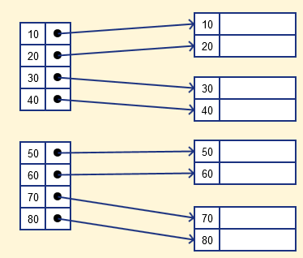
Dense Index
In a dense index, a record is created for every search key valued in the database.
This helps you to search faster but needs more space to store index records.
In this Indexing, method records contain search key value and points to the real record on the disk.

Slide 7
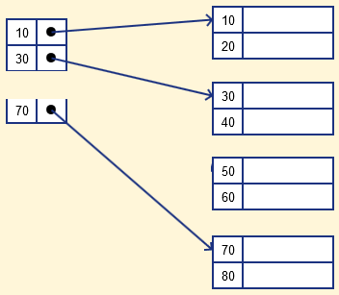
Sparse Index
It is an index record that appears for only some of the values in the file.
Sparse Index helps you to resolve the issues of dense Indexing in DBMS.
In this method of indexing technique, a range of index columns stores the same data block address, and when data needs to be retrieved, the block address will be fetched.
However, sparse Index stores index records for only some search-key values.
It needs less space, less maintenance overhead for insertion, and deletions but
It is slower compared to the dense Index for locating records.

Slide 8
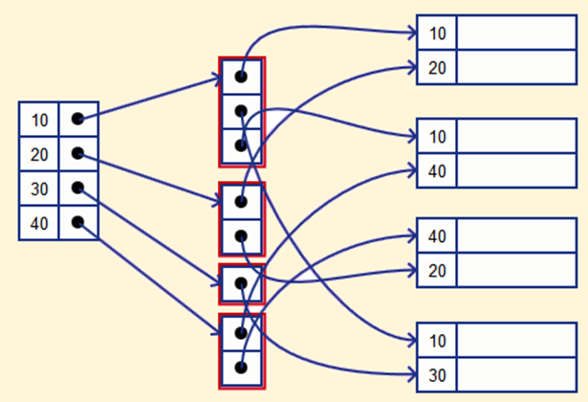
Secondary Index
The secondary Index in DBMS can be generated by a field which has a unique value for each record, and it should be a candidate key. It is also known as a non-clustering index.
This two-level database indexing technique is used to reduce the mapping size of the first level. For the first level, a large range of numbers is selected because of this; the mapping size always remains small.
Example of secondary Indexing
Let's understand secondary indexing with a database index example:
In a bank account database, data is stored sequentially by acc_no; you may want to find all accounts in of a specific branch of BOI bank.
Here, you can have a secondary index in DBMS for every search-key.
Index record is a record point to a bucket that contains pointers to all the records with their specific search-key value.

Slide 9
Clustering Index
In a clustered index, records themselves are stored in the Index and not pointers.
Sometimes the Index is created on non-primary key columns which might not be unique for each record.
In such a situation, you can group two or more columns to get the unique values and create an index which is called clustered Index. This also helps you to identify the record faster.
Example:
Let's assume that a company recruited many employees in various departments. In this case, clustering indexing in DBMS should be created for all employees who belong to the same dept.
It is considered in a single cluster, and index points point to the cluster as a whole. Here, Department_no is a non-unique key.

Slide 10
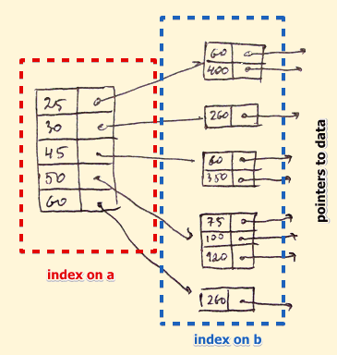
What is Multilevel Index?
Multilevel Indexing in Database is created when a primary index does not fit in memory.
In this type of indexing method, you can reduce the number of disk accesses to short any record and kept on a disk as a sequential file and create a sparse base on that file.

Slide 11

10/03/21 18 students present

Slide 12
B-Tree Index
B-tree index is the widely used data structures for tree based indexing in DBMS.
It is a multilevel format of tree based indexing in DBMS technique which has balanced binary search trees.
All leaf nodes of the B tree signify actual data pointers.
Moreover, all leaf nodes are interlinked with a link list, which allows a B tree to support both random and sequential access.

Slide 13
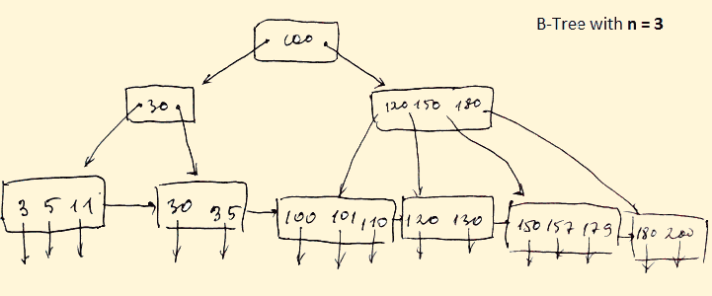
Lead nodes must have between 2 and 4 values.
Every path from the root to leaf are mostly on an equal length.
Non-leaf nodes apart from the root node have between 3 and 5 children nodes.
Every node which is not a root or a leaf has between n/2] and n children.

Slide 14
Advantages of Indexing & Disadvantages of Indexing
Important pros/ advantage of Indexing are:
It helps you to reduce the total number of I/O operations needed to retrieve that data, so you don't need to access a row in the database from an index structure.
Offers Faster search and retrieval of data to users.
Indexing also helps you to reduce tablespace as you don't need to link to a row in a table, as there is no need to store the ROWID in the Index. Thus you will able to reduce the tablespace.
You can't sort data in the lead nodes as the value of the primary key classifies it.
Disadvantages of Indexing
Important drawbacks/cons of Indexing are:
To perform the indexing database management system, you need a primary key on the table with a unique value.
You can't perform any other indexes in Database on the Indexed data.
You are not allowed to partition an index-organized table.
SQL Indexing Decrease performance in INSERT, DELETE, and UPDATE query.

Slide 15
Summary:
Indexing is a small table which is consist of two columns.
Two main types of indexing methods are 1)Primary Indexing 2) Secondary Indexing.
Primary Index is an ordered file which is fixed length size with two fields.
The primary Indexing is also further divided into two types 1)Dense Index 2)Sparse Index.
In a dense index, a record is created for every search key valued in the database.
A sparse indexing method helps you to resolve the issues of dense Indexing.
The secondary Index in DBMS is an indexing method whose search key specifies an order different from the sequential order of the file.
Clustering index is defined as an order data file.
Multilevel Indexing is created when a primary index does not fit in memory.
The biggest benefit of Indexing is that it helps you to reduce the total number of I/O operations needed to retrieve that data.
The biggest drawback to performing the indexing database management system, you need a primary key on the table with a unique value

Slide 16
Sub-queries
Sales_order
A sub query is a for of an SQL statement that appeared inside another SQL. It is also termed as nested query.
The statement containing a Sub query is called a parent statement, the parent statement uses the rows returned by sub query
Q 1: Retrieve all orders placed by a client named a RAHUL from the sales order table
Order_no | Client_no | Order date
1 | C106 | 02/02/20
2 | C105 | 25/12/20
3 | C107 | 26/12/20
4 | C105 | 18/01/21
5 | C102 | 20/01/21
6 | C107 | 25/01/21
Client_master
Client_no | Name | Balance
C101 | ASHISH | 5000
C102 | VISHAKHA | 3256
C103 | ANUP | 6398
C104 | RUPALI | 7896
C105 | RAHUL | 2586
C106 | KAVITA | 1236
C107 | DHANASHREE | 8597
Notes:
Select * from sales_order where client_no =(select client_no from client_master where name=‘RAHUL’);

Slide 17
Query
Select * from sales_order where client_no =(select client_no from client_master where name=‘RAHUL’);
Order_no | Client_no | Order date
2 | C105 | 25/12/20
4 | C105 | 18/01/21

Slide 18
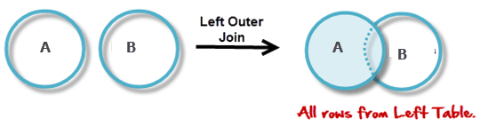
Join
Join in DBMS is a binary operation which allows you to combine join product and selection in one single statement. The goal of creating a join condition is that it helps you to combine the data from two or more DBMS tables. The tables in DBMS are associated using the primary key and foreign keys. ... Types of Join.

Slide 19
What is Join in DBMS?
Join in DBMS is a binary operation which allows you to combine join product and selection in one single statement. The goal of creating a join condition is that it helps you to combine the data from two or more DBMS tables. The tables in DBMS are associated using the primary key and foreign keys.
Sometimes we required t treat multiple tables as through they where a single entity . Then a single SQL sentence can Manipulate data from the tables . To achieve this we have to join tables . Tables are joined on columns that have same data types and data width in the tables .
Notes:
https://www.guru99.com/joins-sql-left-right.html#2

Slide 20
We can define the three operations UNION, INTERSECTION, and SET DIFFERENCE
We can define the three operations UNION, INTERSECTION, and SET DIFFERENCE on two union-compatible relations R and S as follows:
■ UNION: The result of this operation, denoted by R ∪ S, is a relation that includes all tuples that are either in R or in S or in both R and S. Duplicate tuples are eliminated.
■ INTERSECTION: The result of this operation, denoted by R ∩ S, is a relation that includes all tuples that are in both R and S.
■ SET DIFFERENCE (or MINUS): The result of this operation, denoted by R – S, is a relation that includes all tuples that are in R but not in S.

Slide 21
6.2.2 The CARTESIAN PRODUCT (CROSS PRODUCT) Operation Next, we discuss the CARTESIAN PRODUCT operation—also known as CROSS PRODUCT or CROSS JOIN—which is denoted by ×. This is also a binary set operation, but the relations on which it is applied do not have to be union compatible. In its binary form, this set operation produces a new element by combining every member (tuple) from one relation (set) with every member (tuple) from the other relation (set). In general, the result of R(A1, A2, ..., An) × S(B1, B2, ..., Bm) is a relation Q with degree n + m attributes Q(A1, A2, ..., An, B1, B2, ..., Bm), in that order. The resulting relation Q has one tuple for each combination of tuples—one from R and one from S. Hence, if R has nR tuples (denoted as |R| = nR), and S has nS tuples, then R × S will have nR * nS tuples. The n-ary CARTESIAN PRODUCT operation is an extension of the above concept, which produces new tuples by concatenating all possible combinations of tuples from n underlying relations. In general, the CARTESIAN PRODUCT operation applied by itself is generally meaningless. It is mostly useful when followed by a selection that matches values of attributes coming from the component relations. For example, suppose that we want to retrieve a list of names of each female employee’s dependents. We can do this as follows:

Slide 22
Joinning multiple tables (Equi join)
Retrieve the order_no ,client_names and their order dates from the client_master and sales _order tables. The order date should be displayed in ‘DD/MM/YYYY’ format and stored in ascending order.
Sales_order
Client_master
Order_no | Client_no | Order date
1 | C106 | 02/02/20
2 | C105 | 25/12/20
3 | C107 | 26/12/20
4 | C105 | 18/01/21
5 | C102 | 20/01/21
6 | C107 | 25/01/21
Client_no | Name | Balance
C101 | ASHISH | 5000
C102 | VISHAKHA | 3256
C103 | ANUP | 6398
C104 | RUPALI | 7896
C105 | RAHUL | 2586
C106 | KAVITA | 1236
C107 | DHANASHREE | 8597
Notes:
Select order_no,name,to_char(order_date,’DD/MM/YYYY’) “ORDER DATE” from sales_order ,cLient_master where client_master.client_no=sales_order.client_no order by to_char(order_date,’DD/MM/YYYY’);

Slide 23
Select order_no, name, order_date from sales_order ,client_master where client_master.client_no=sales_order.client_no order by order_date);
Order_no | Client_no | Order date
1 | C106 | 25-12-2020
2 | C105 | 02-12-2020
3 | C107 | 12-12-2020
4 | C105 | 18-02-2021
5 | C102 | 20-01-2021
6 | C107 | 25-01-2021
Client_no | Name
C101 | ASHISH
C102 | VISHAKHA
C103 | ANUP
C104 | RUPALI
C105 | RAHUL
C106 | KAVITA
C107 | DHANASHREE

Slide 24
Select order_no,name, to_char (order_date,’DD/MM/YYYY’) “ORDER DATE” from sales_order ,cLient_master where client_master.client_no=sales_order.client_no order by to_char(order_date,’DD/MM/YYYY’);
OUTPUT
Order_no | Client_no | Name | Order date
2 | C105 | RAHUL | 02-12-2020
3 | C107 | DHANASHREE | 12-12-2020
1 | C106 | KAVITA | 25-12-2020
5 | C102 | VISHAKHA | 20-01-2021
6 | C107 | DHANASHREE | 25-01-2021
4 | C105 | RAHUL | 18-02-2021

Slide 25
Example 2
Retrieve The Product Number , their Description And total Quantity Order For Each Product
PRODUCT_MASTER
SALES_ORDER_DETAIL
PRODUC _NO | DESCRIPTION
P1 | MOUSE
P2 | PRINTER
P3 | SCANNER
P4 | KEYBOARD
P5 | MONITOR
P6 | CD DRIVE
P7 | HDD
P8 | CCTV CAMERA
P9 | XEROX MACHNE
ORDER_NO | PRODUCT_NO | QTY_ORDER
O101 | P1 | 100
O101 | P4 | 95
O101 | P6 | 05
O102 | P2 | 08
O102 | P5 | 35
O103 | P3 | 05
O104 | P1 | 36
O105 | P6 | 43
O105 | P4 | 55
O106 | P6 | 10
SELECT sales_order_detail.product_no, description, sum(qty_ordered) FROM SALES_ORDER_DETIL, PRODUCT_MASTER WHERE PRODUCT_MASTER.PRODUCT_NO=SALES_ORDER_DETAIL.PRODUCT_NO GROUP BY SALES_ORDERR_DETAIL.PRODUCT_NO, DESCTIPTION;

Slide 26
SOLUTION
SELECT sales_order_detail.product_no, description, sum(qty_ordered) ” total QTY ordered” FROM SALES_ORDER_DETIL, PRODUCT_MASTER WHERE PRODUCT_MASTERR.PRODUCT_NO=SALES_ORDER_ETAIL.PRODUCT_NO GROUP BY SALES_ORDERR_DETAIL.PRODUCT_NO, DESCTIPTION;
OUTPUT AS FOLLOWS
PRODUC _NO | DESCRIPTION | TOTAL_QTY_ORDERR
P1 | MOUSE | 136
P2 | PRINTER | 8
P3 | SCANNER | 5
P4 | KEYBOARD | 150
P5 | MONITOR | 35
P6 | CD DRIVE | 58

Slide 27
USING UNION,INTERSECT ,MINUS CLAUS
UNION CLAUSE: multiple queries can be put togetherr and their output combined using the union clause. The union claues merges the output of two or more queries into as ingle set of rows and columns
Output= Records only in query One + Records only in query Two+ single set of records which is common in both queries
Records only in query
one
Records only in query
Two
Common records in both queries

Slide 28
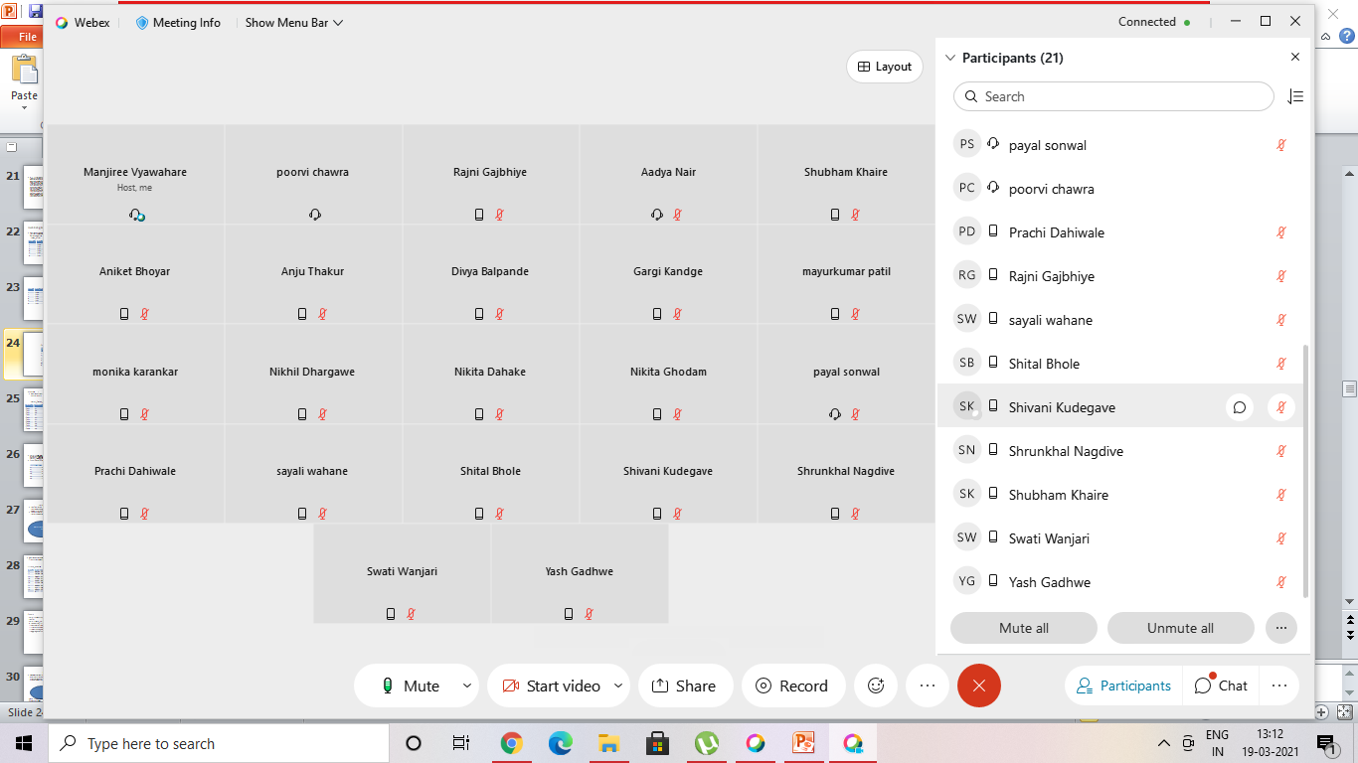
19/03/21

Slide 29
Union :- Retrieve the names of all the client and salesmen in the city of “NAGPUR” from the tables client_master and sales_master
SALESMAN_MASTER
CLIENT_MASTER
Salesman_no | Name | City
S1 | ABOLI | NAGPUR
S2 | YETHESHYAM | PUNE
S3 | SHWETA | NAGPUR
S4 | AACHAL | AMRAVATI
S5 | KIRTI | NAGPUR
Client_no | Name | City
C1 | AADYA | GONDIA
C2 | SHUBH | NAGPUR
C3 | GARGI | PUNE
C4 | POORVI | PUNE
C5 | PAYAL | AMRAVATI
C6 | DIVYA | NAGPUR
C7 | ABHAY | WARDHA
C8 | NIKITA | NAGPUR
C9 | MONIKA | GONDIA

Slide 30
OUTPUT
SELECT salesman_no,name FROM salesman_master where city=‘NAGPUR’
UNION
SELECT client_no,name FROM client_master where city=‘NAGPUR’’;
THE RESTRICTION ON USING A UNION ARE AS FOLLOWS
Number of columns in all the queries should be the same
The data type of the column in each query must be same
Union cannot be used in sub queries
Aggregate functions cannot be used with union clause
ID | NAME | CITY
C2 | SHUBH | NAGPUR
C6 | DIVYA | NAGPUR
C8 | NIKITA | NAGPUR
S1 | ABOLI | NAGPUR
S3 | SHWETA | NAGPUR
S5 | KIRTI | NAGPUR

Slide 31
Intersect Clause
Multiple queries can be put together and their output combined using the intersect clause . The intersect clause outputs only rows produced by both the queries intersected. The output in an intersect clause will include only those rows that are retrieved by both the queries.
Excel Link
Common records in both queries
Note: The output f the both the queries will be displayed as above. The final output will be :
Output=a single set of records which are common in bot the the queries

Slide 32
Intersect:- Retrieve the salesman names in “NAGPUR” whose efforts have resulted into at least one sales transaction.
SALES_ORDER
Salesman_master
Order_no | SALESMAN_no | Order date
O1 | S1 | 02-12-2020
O2 | S3 | 12-12-2020
O3 | S1 | 25-12-2020
O4 | S4 | 20-01-2021
O5 | S3 | 25-01-2021
O6 | S2 | 18-02-2021
Salesman No | Name | City
S1 | AADYA | NAGPUR
S2 | SHUBH | DELHI
S3 | GARGI | NAGPUR
S4 | POORVI | PUNE
S5 | PAYAL | AMRAVATI

Slide 33
SELECT salesman_no,name FROM salesman_master WHERE city=‘NAGPUR’
INERSECT
SELECT salesman_master.salesman_no, name FROM salesman_master,sales_order WHERE salesman_master.salesman_no=sales_order.salesman_no;
2. QUERY OUTPUT
SALESMAN_no | Name
S1 | AADYA
S3 | GARGI
S1 | AADYA
S4 | POORVI
S3 | GARGI
S2 | SHUBH
1. SELECT salesman_no,name FROM salesman_master WHERE city=‘NAGPUR’
Salesman No | Name
S1 | AADYA
S3 | GARGI
3. INSERT CLAUSE PIKUP THE RECORDS THOISE ARE COMMON NBOTH THE QUERIES
Salesman No | Name
S1 | AADYA
S3 | GARGI

Slide 34
MINUS CLAUSE
Multiple queries can be put together and their output combined using the minus clause. The minis clause outputs the rows produced by the first query , after filtering the rows retrieved by the second query.
Records only in query one

Slide 35
Retrieve all the product numbers of non-moving items from the product_master table
Sales_order_details
PRODUCT_MASTER
Order_no | Product_no
O1 | P1
O1 | P4
O1 | P6
O2 | P2
O2 | P5
O3 | P3
O4 | P1
O5 | P6
O5 | P4
O6 | P6
PRODUC _NO | DESCRIPTION
P1 | MOUSE
P2 | PRINTER
P3 | SCANNER
P4 | KEYBOARD
P5 | MONITOR
P6 | CD DRIVE
P7 | HDD
P8 | CCTV CAMERA
P9 | XEROX MACHNE

Slide 36
SELECT product_no FROM product_master
MINUS
SELECT product_no FROM sales_order_detil;
Minus clause picks up records in the first query after filtering the retrieved records from the second query
The output after minus clause will be as follows
PRODUC _NO
P1
P2
P3
P4
P5
P6
P7
P8
P9
Product_no
P1
P4
P6
P2
P5
P3
P1
P6
P4
P6
PRODUC _NO
P7
P8
P9

Slide 37
Types of Join
There are mainly two types of joins in DBMS:
Inner Joins: Theta, Natural, EQUI
Outer Join: Left, Right, Full

Slide 38
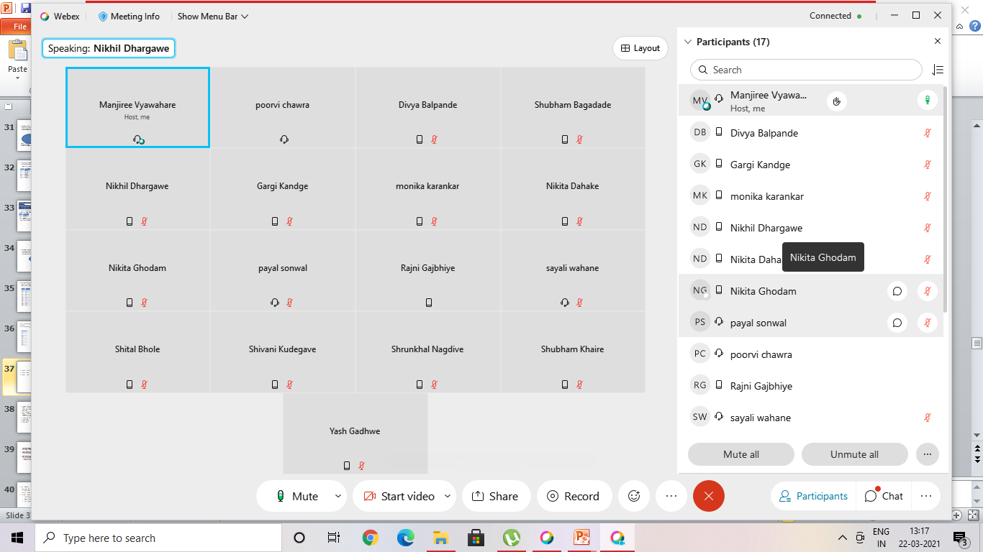
22/03/2021

Slide 39
Inner Join
INNER JOIN is used to return rows from both tables which satisfy the given condition. It is the most widely used join operation and can be considered as a default join-type
An Inner join or equijoin is a comparator-based join which uses equality comparisons in the join-predicate. However, if you use other comparison operators like ">" it can't be called equijoin.
Inner Join further divided into three subtypes:
Theta join
Natural join
EQUI join

Slide 40
Inner Join
THETA JOIN allows you to merge two tables based on the condition represented by theta. Theta joins work for all comparison operators. It is denoted by symbol θ. The general case of JOIN operation is called a Theta join.
EQUI JOIN is done when a Theta join uses only the equivalence condition. EQUI join is the most difficult operation to implement efficiently in an RDBMS, and one reason why RDBMS have essential performance problems.
NATURAL JOIN does not utilize any of the comparison operators. In this type of join, the attributes should have the same name and domain. In Natural Join, there should be at least one common attribute between two relations.
It performs selection forming equality on those attributes which appear in both relations and eliminates the duplicate attributes.

Slide 41
Outer Join
An OUTER JOIN doesn't require each record in the two join tables to have a matching record. In this type of join, the table retains each record even if no other matching record exists.
Three types of Outer Joins are:
Left Outer Join
Right Outer Join
Full Outer Join

Slide 42
Left Outer Join (A B)
LEFT JOIN returns all the rows from the table on the left even if no matching rows have been found in the table on the right. When no matching record found in the table on the right, NULL is returned.

Slide 43
Right Outer Join ( A B )
RIGHT JOIN returns all the columns from the table on the right even if no matching rows have been found in the table on the left. Where no matches have been found in the table on the left, NULL is returned. RIGHT outer JOIN is the opposite of LEFT JOIN
In our example, let's assume that you need to get the names of members and movies rented by them. Now we have a new member who has not rented any movie yet.

Slide 44
Summary
There are mainly two types of joins in DBMS 1) Inner Join 2) Outer Join
An inner join is the widely used join operation and can be considered as a default join-type.
Inner Join is further divided into three subtypes: 1) Theta join 2) Natural join 3) EQUI join
Theta Join allows you to merge two tables based on the condition represented by theta
When a theta join uses only equivalence condition, it becomes an equi join.
Natural join does not utilize any of the comparison operators.
An outer join doesn't require each record in the two join tables to have a matching record.
Outer Join is further divided into three subtypes are: 1)Left Outer Join 2) Right Outer Join 3) Full Outer Join
The LEFT Outer Join returns all the rows from the table on the left, even if no matching rows have been found in the table on the right.
The RIGHT Outer Join returns all the columns from the table on the right, even if no matching rows have been found in the table on the left.
In a full outer join, all tuples from both relations are included in the result, irrespective of the matching condition.

Slide 45
Implementing the JOIN Operation
The JOIN operation is one of the most time-consuming operations in query processing.
Many of the join operations encountered in queries are of the EQUIJOIN and NATURAL JOIN varieties, so we consider just these two here since we are only giving an overview of query processing and optimization.
There are many possible ways to implement a two-way join, which is a join on two files. Joins involving more than two files are called multiway joins.
The number of possible ways to execute multiway joins grows very rapidly.
once more—specifically, to the EMPLOYEE, DEPARTMENT, and PROJECT relations. The algorithms we discuss next are for a join operation of the form: R A=B S where A and B are the join attributes, which should be domain-compatible attributes of R and S, respectively.
The methods we discuss can be extended to more general forms of join. We illustrate four of the most common techniques for performing such a join, using the following sample operations
OP6: EMPLOYEE Dno=Dnumber DEPARTMENT
OP7: DEPARTMENT Mgr_ssn=Ssn EMPLOYEE

Slide 46
Methods for Implementing Joins.
J1—Nested-loop join (or nested-block join). This is the default (brute force) algorithm, as it does not require any special access paths on either file in the join.
For each record t in R (outer loop), retrieve every record s from S (inner loop) and test whether the two records satisfy the join condition t[A] = s[B].9
J2—Single-loop join (using an access structure to retrieve the matching records).
If an index (or hash key) exists for one of the two join attributes— say, attribute B of file S—retrieve each record t in R (loop over file R), and then use the access structure (such as an index or a hash key) to retrieve directly all matching records s from S that satisfy s[B] = t[A

Slide 47
J3—Sort-merge join.
If the records of R and S are physically sorted (ordered) by value of the join attributes A and B, respectively, we can implement the join in the most efficient way possible.
Both files are scanned concurrently in order of the join attributes, matching the records that have the same values for A and B.
If the files are not sorted, they may be sorted first by using external sorting. In this method, pairs of file blocks are copied into memory buffers in order and the records of each file are scanned only once each for

Slide 48
matching with the other file—unless both A and B are nonkey attributes, in which case the method needs to be modified slightly.
A sketch of the sortmerge join algorithm is given in Figure 19.3(a). We use R(i) to refer to the ith record in file R.
A variation of the sort-merge join can be used when secondary indexes exist on both join attributes.
The indexes provide the ability to access (scan) the records in order of the join attributes, but the records themselves are physically scattered all over the file blocks, so this method may be quite inefficient, as every record access may involve accessing a different disk block.

Slide 49
J4—Partition-hash join.
The records of files R and S are partitioned into smaller files. The partitioning of each file is done using the same hashing function h on the join attribute A of R (for partitioning file R) and B of S (for partitioning file S).
First, a single pass through the file with fewer records (say, R) hashes its records to the various partitions of R; this is called the partitioning phase,
since the records of R are partitioned into the hash buckets. In the simplest case, we assume that the smaller file can fit entirely in main memory after it is partitioned, so that the partitioned subfiles of R are all kept in main memory.
The collection of records with the same value of h(A) are placed in the same partition, which is a hash bucket in a hash table in main memory.
In the second phase, called the probing phase, a single pass through the other file (S) then hashes each of its records using the same hash function h(B) to probe the appropriate bucket, and that record is combined with all matching records from R in that bucket.
This simplified description of partition-hash join assumes that the smaller of the two files fits entirely into memory buckets after the first phase.
We will discuss the general case of partition-hash join that does not require this assumption below.
In practice, techniques J1 to J4 are implemented by accessing whole disk blocks of a file, rather than individual records.
Depending on the available number of buffers in memory, the number of blocks read in from the file can be adjusted.

Slide 50
How Buffer Space and Choice of Outer-Loop File Affect Performance of Nested-Loop Join.
The buffer space available has an important effect on some of the join algorithms.
First, let us consider the nested-loop approach (J1).
Looking again at the operation OP6 above, assume that the number of buffers available in main memory for implementing the join is nB = 7 blocks (buffers).
Recall that we assume that each memory buffer is the same size as one disk block.
For illustration, assume that the DEPARTMENT file consists of rD = 50 records stored in bD = 10 disk blocks and that
the EMPLOYEE file consists of rE = 6000 records stored in bE = 2000 disk blocks.
It is advantageous to read as many blocks as possible at a time into memory from the file whose records are used for the outer loop (that is, nB − 2 blocks).
The algorithm can then read one block at a time for the inner-loop file and use its records to probe (that is, search)
the outer-loop blocks that are currently in main memory for matching records. This reduces the total number of block accesses.
An extra buffer in main memory is needed to contain the resulting records after they are joined, and the contents of this result buffer can be appended to the result file—the disk file that will contain the join result—whenever it is filled.
This result buffer block then is reused to hold additional join result records.

